Slide 1



Intelligent Energy Management System for Buildings
Hong Kong Institute of Vocational Education
IT114105-2A
Final Year Project

Slide 2



2
Our Team
CHAN, Shing Wai William
WONG, Man Yu Henry
TSUI, Ming Chun Maverick
HUI, Ping Yin Ricky
Yr 2 - Student
Yr 2 - Student
Yr 2 - Student
Yr.2 - Student
HD in Software Engineering
180140441
HD in Software Engineering
180101095
HD in Software Engineering
1800091510
HD in Software Engineering
180216821
Supervisors
WONG, Hang-chit
Lecturer
IVE(Chai Wan), HKSAR
People vector created by Sapann-Design - www.freepik.com

Slide 3
3
Agenda
1. Project Overview
2. Design Concept
3. System Structure
4. Implementation

Slide 4


Slide 5
5
System stakeholders
Estate Management
Sensor management and scheduling control
Room user
Reflect the “feeling”
System Intelligent
Maintain best indoor environment

Slide 6
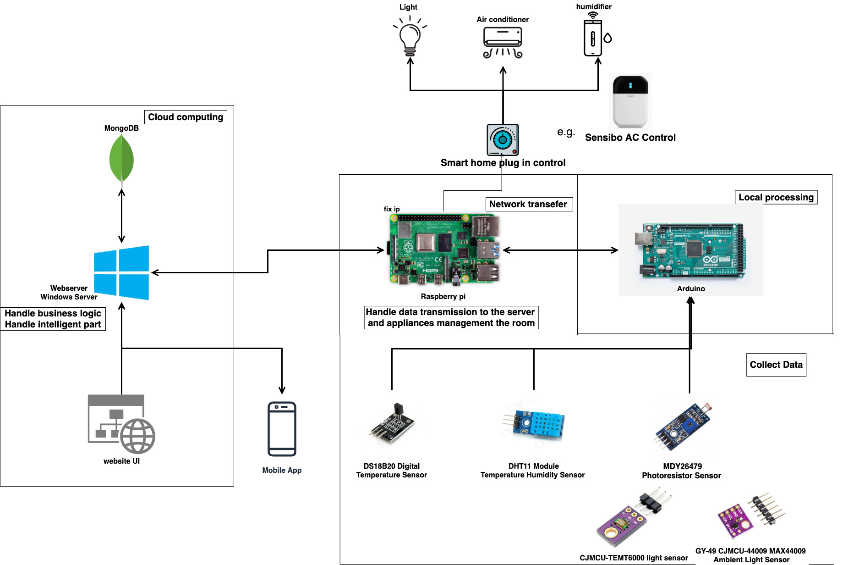
6
Hardware architecture

Slide 7
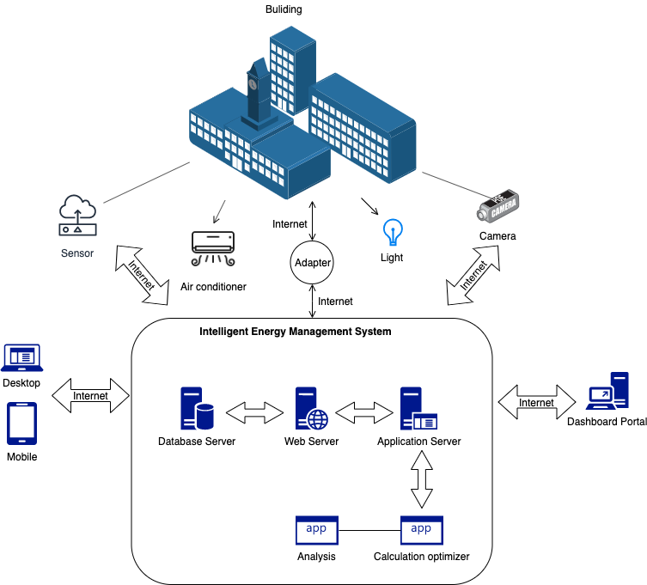
7
System Architecture

Slide 8
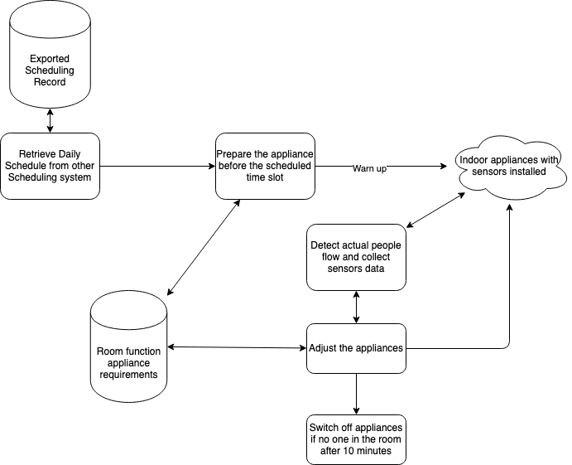
8
System Workflow (Overview)
1
2
3
4
Prepare
5
4
5

Slide 9
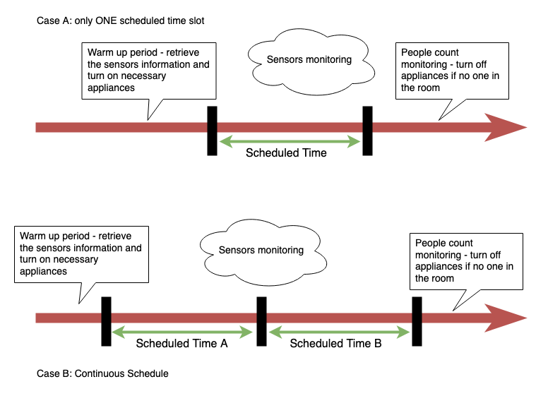
9
System Workflow (Case Study)

Slide 10
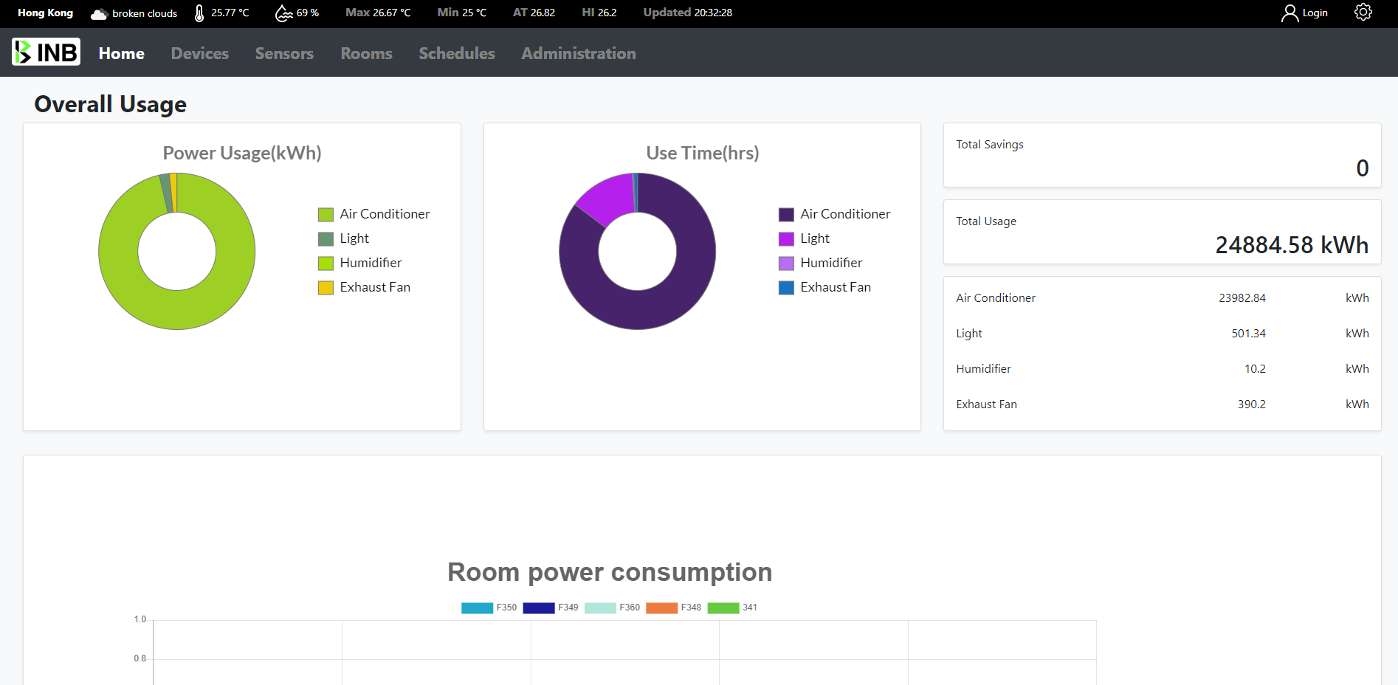
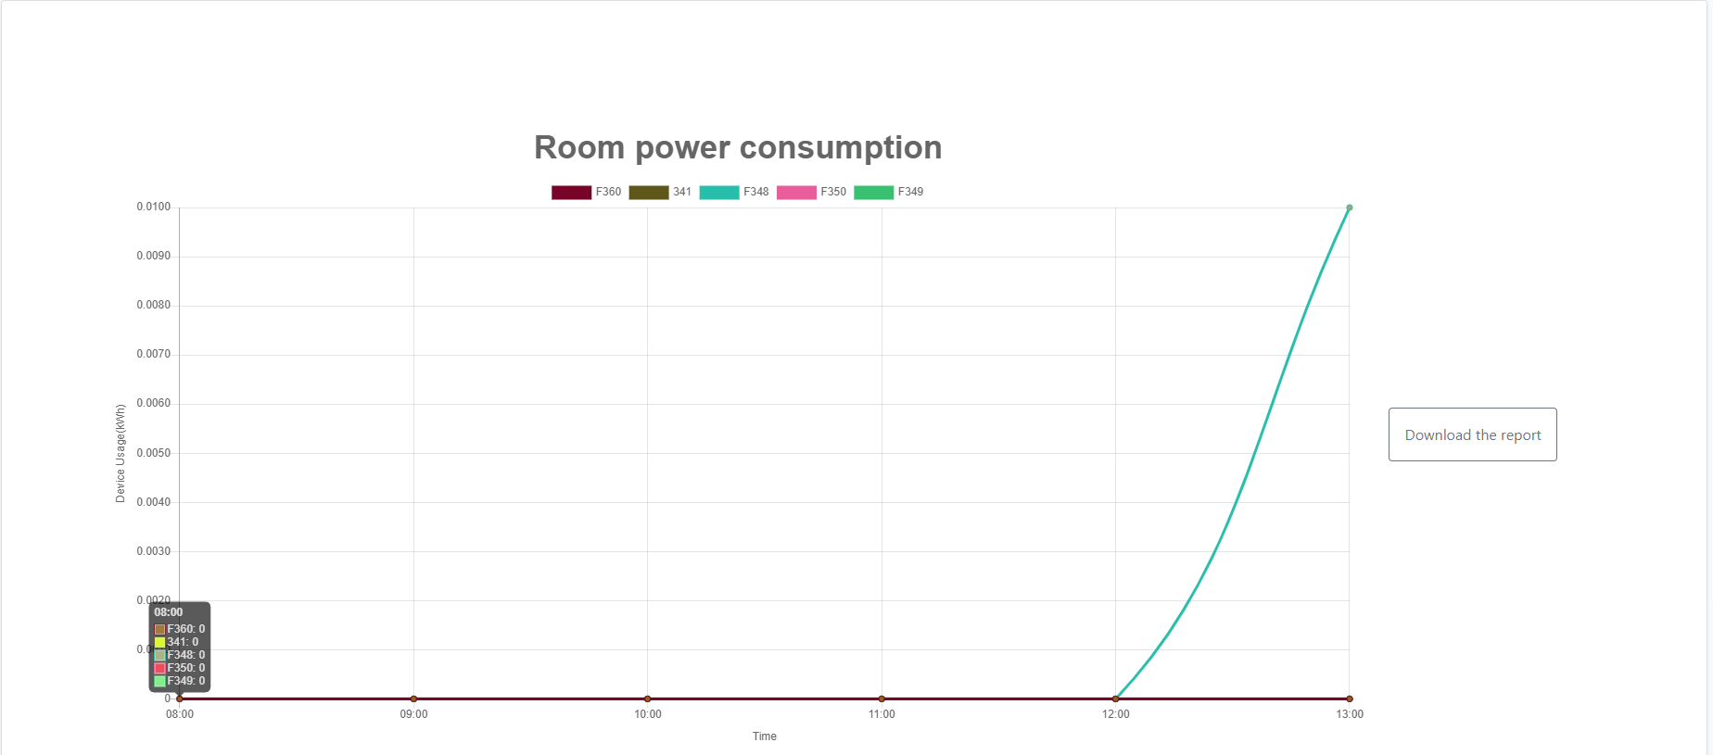
10
Real-time dashboard
Monitoring all the power usage
Teal time monitoring
Including power usage, sensors status
A function to retrieve data reports (power usage)

Slide 11
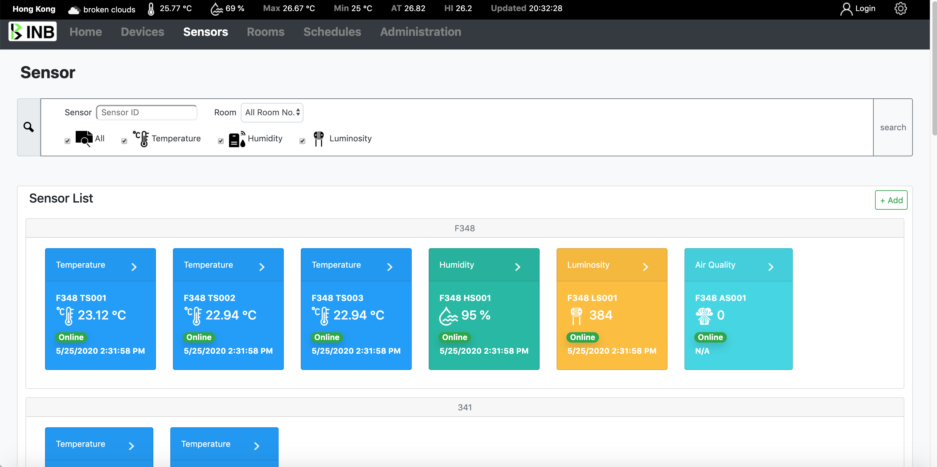
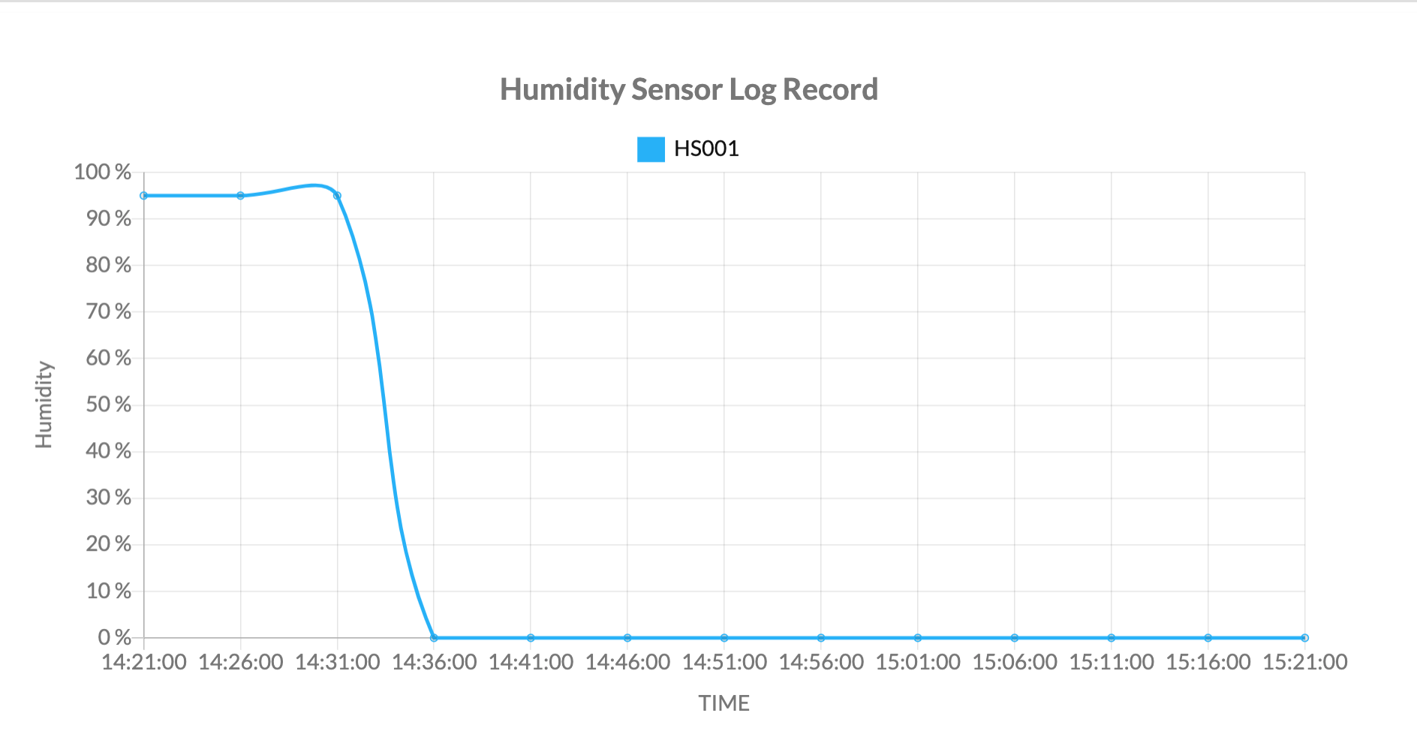
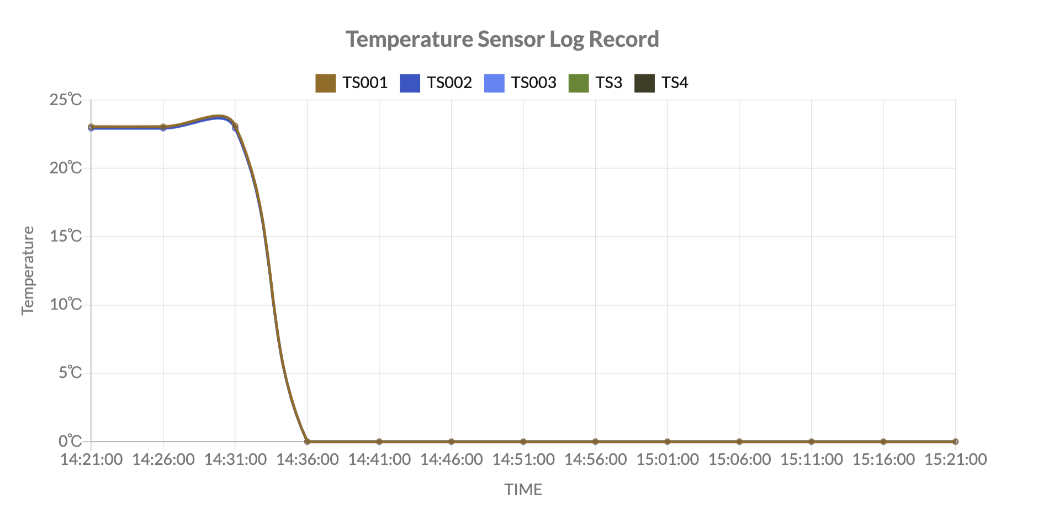
11
Sensors data monitoring
Monitoring all the sensors
Like temperature, humidity and lighting
Provide trend chart

Slide 12
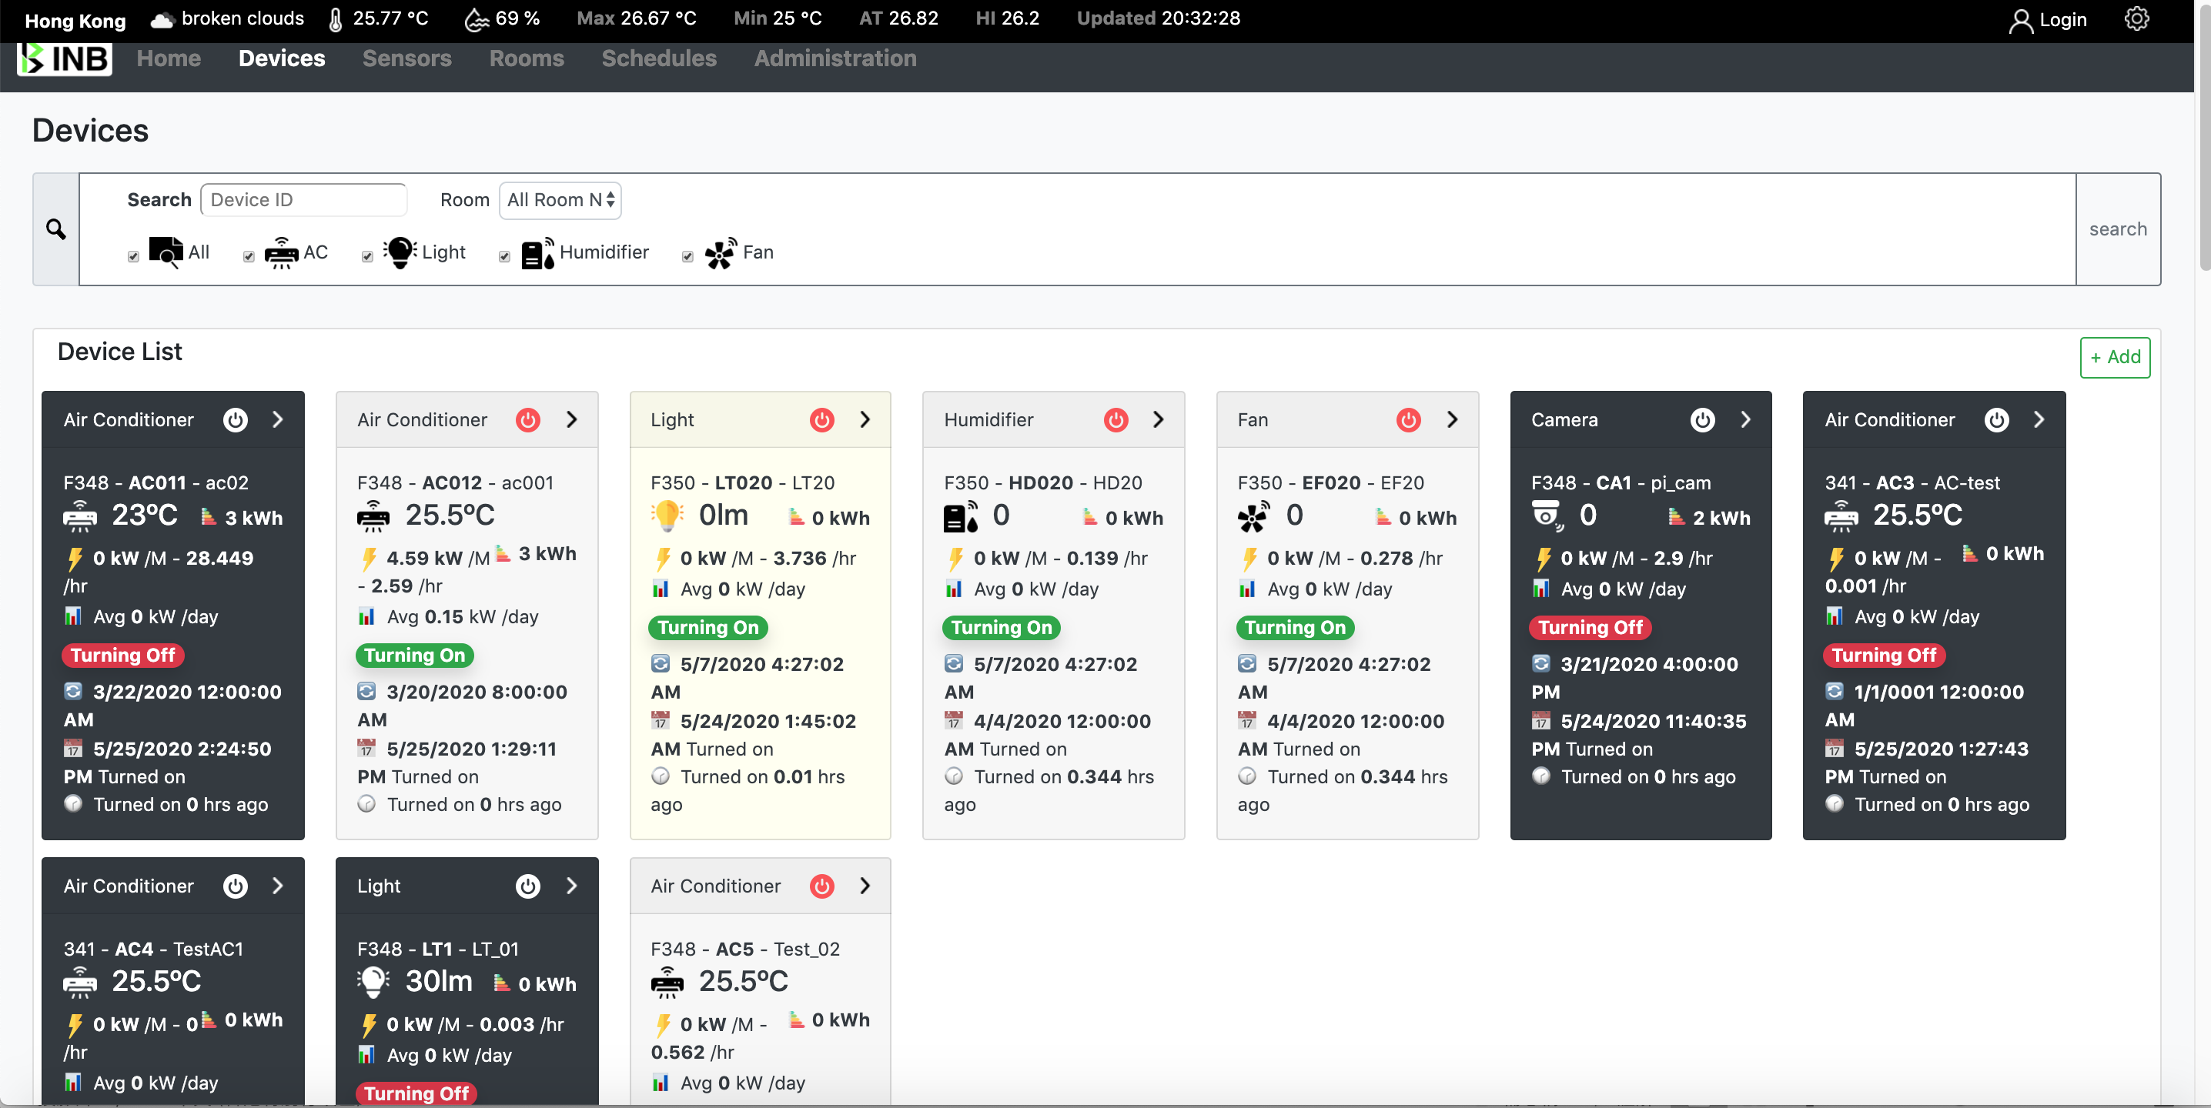
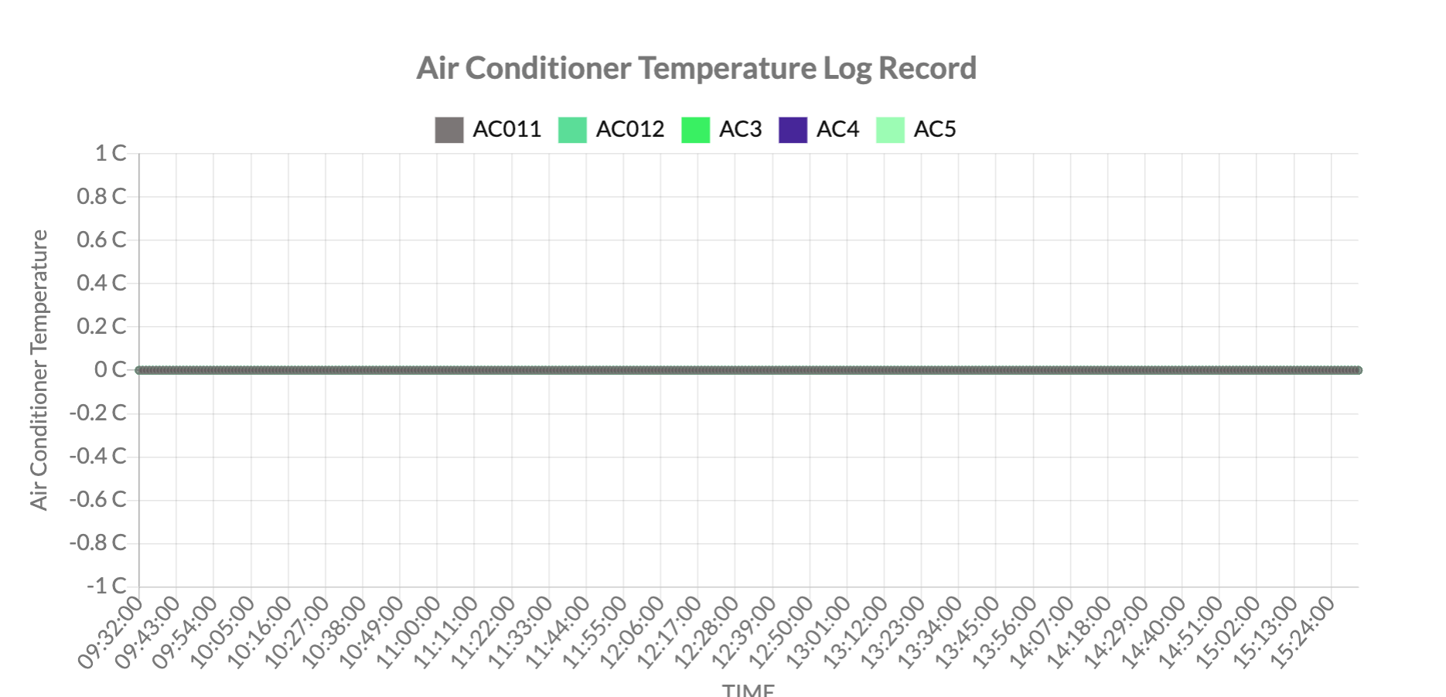
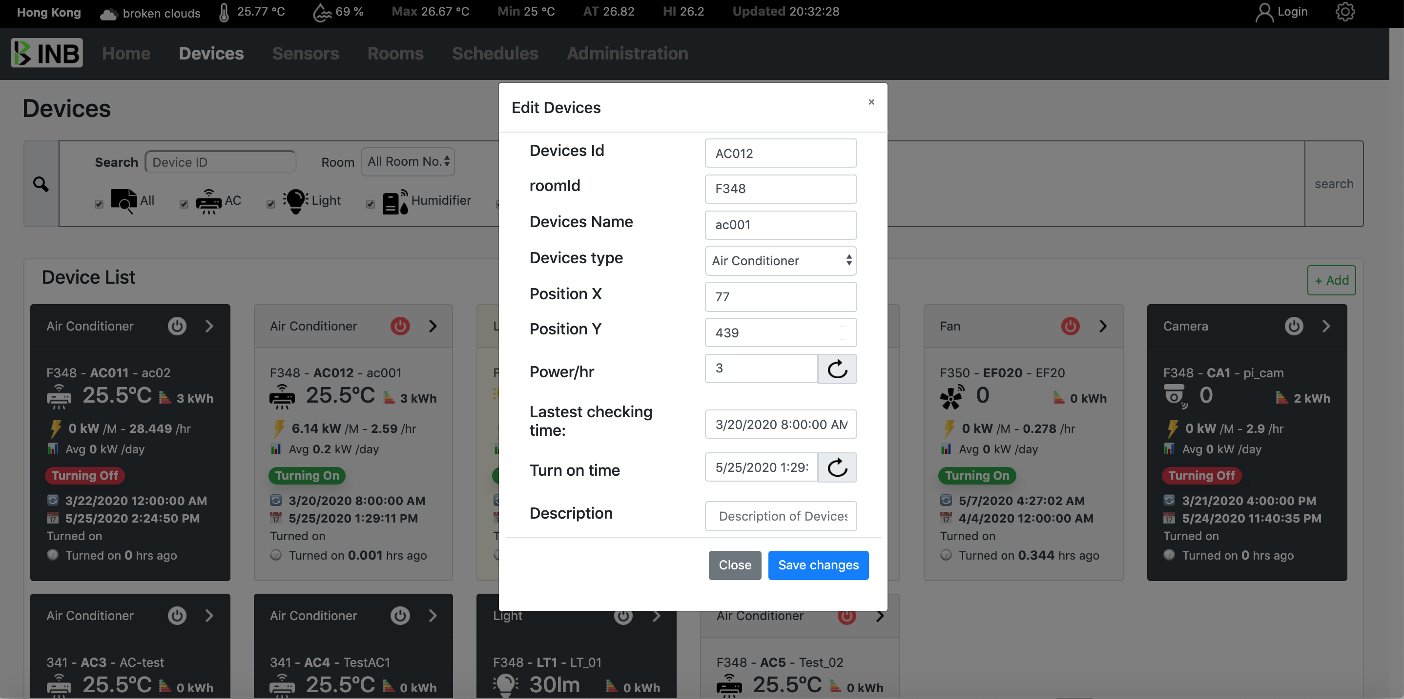
12
Appliances control
Manually control the devices
Turn on / off
Real time status

Slide 13
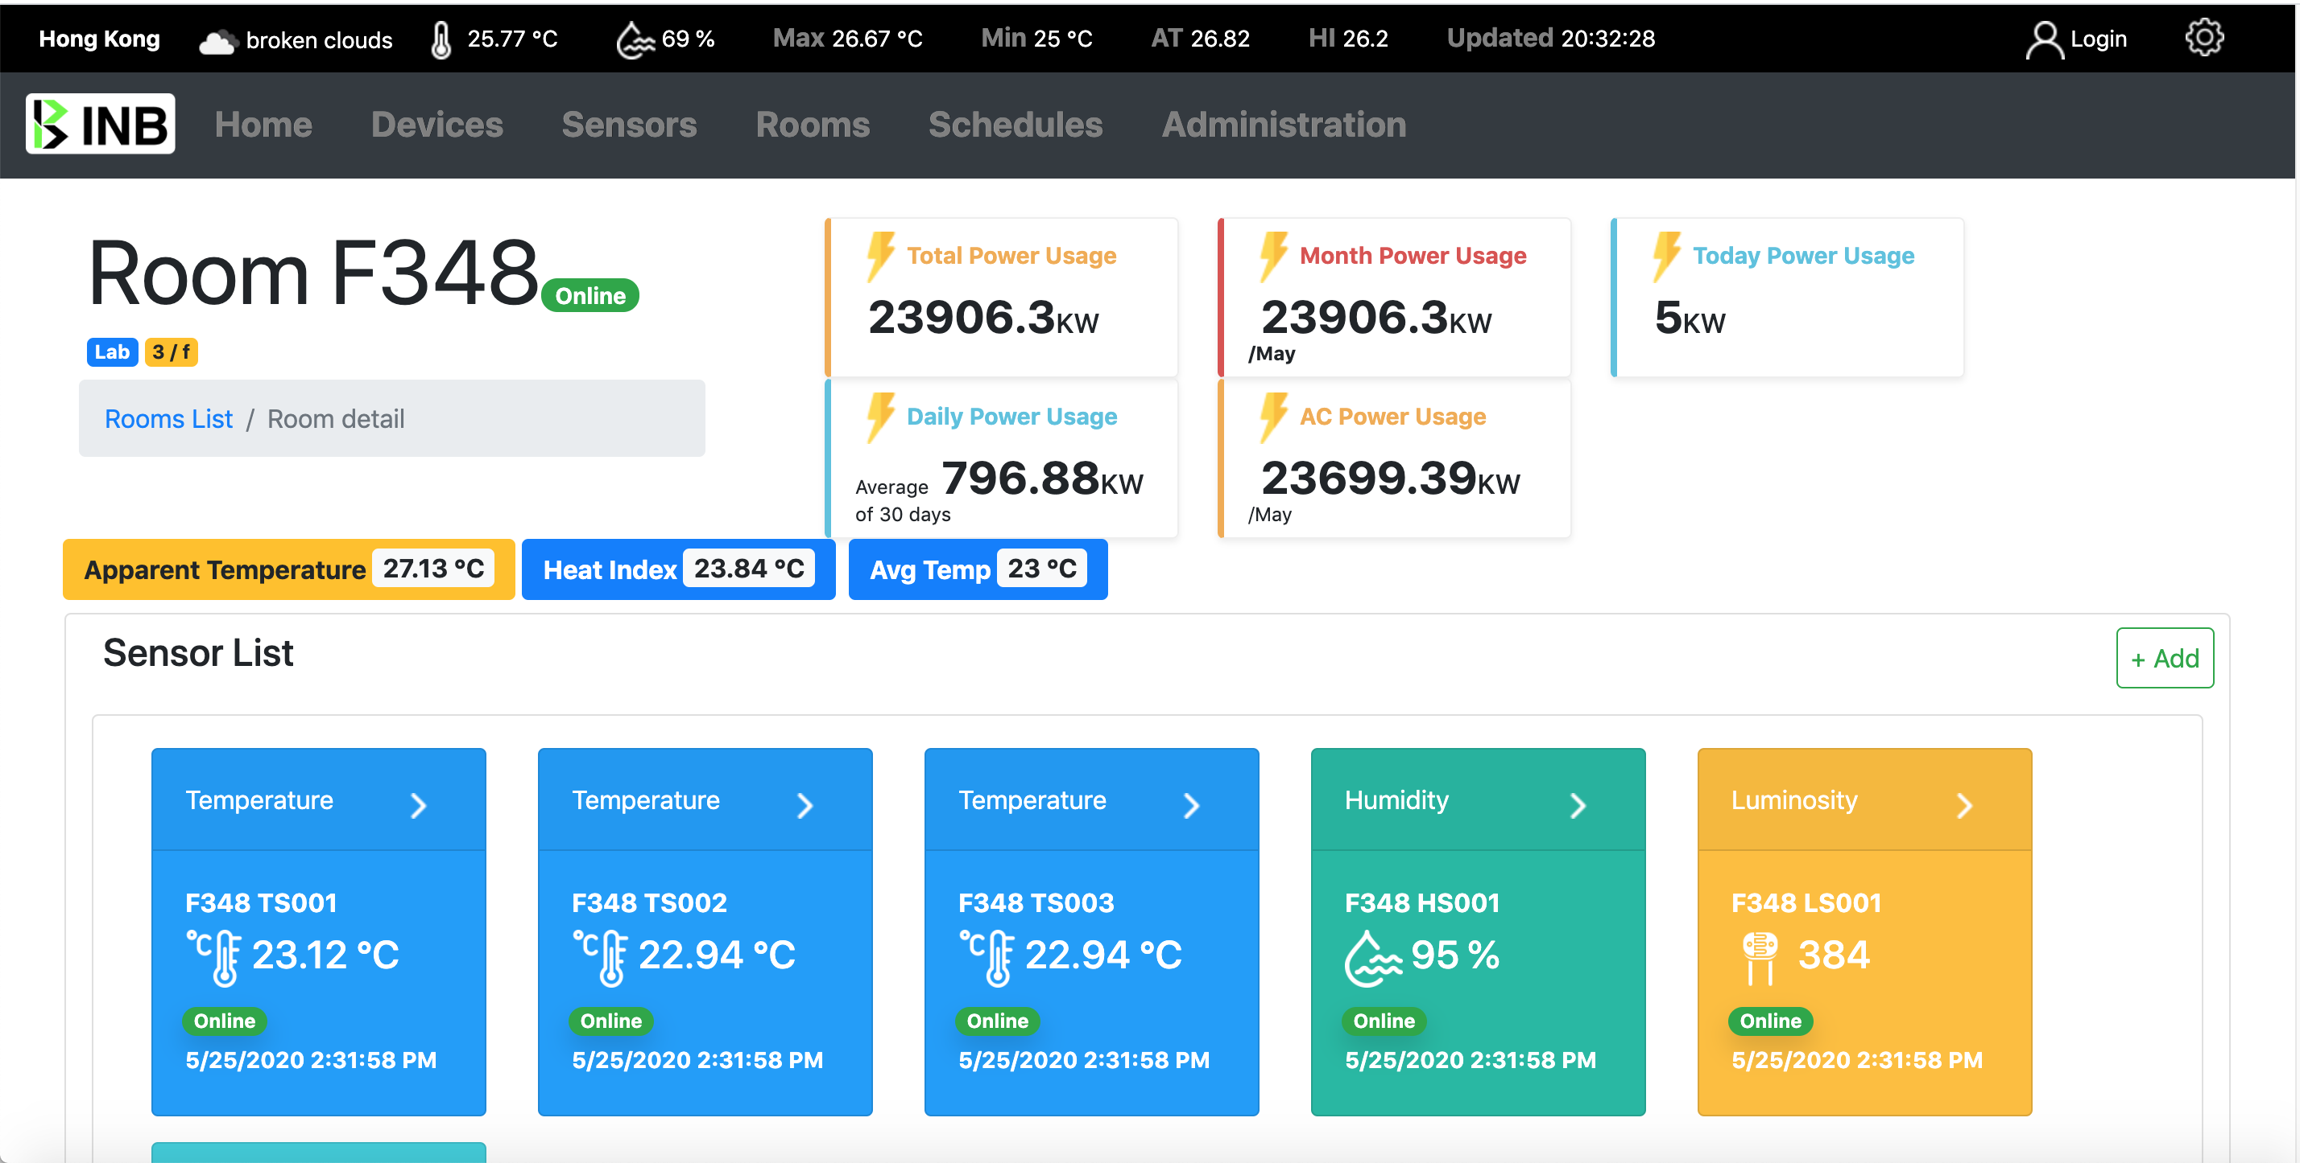
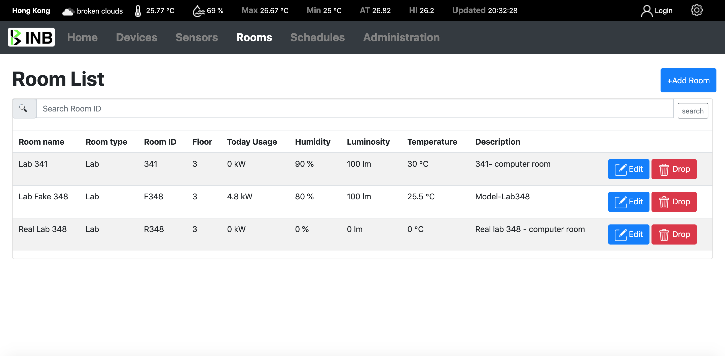
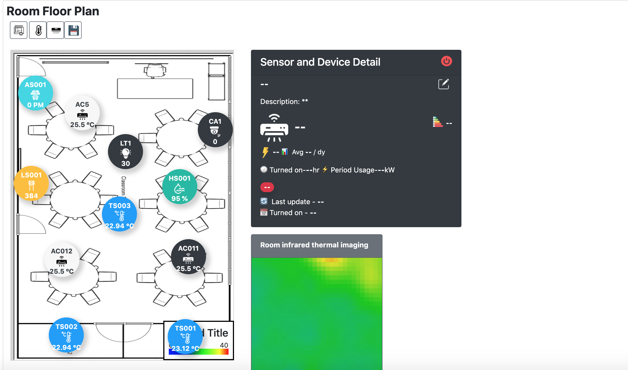
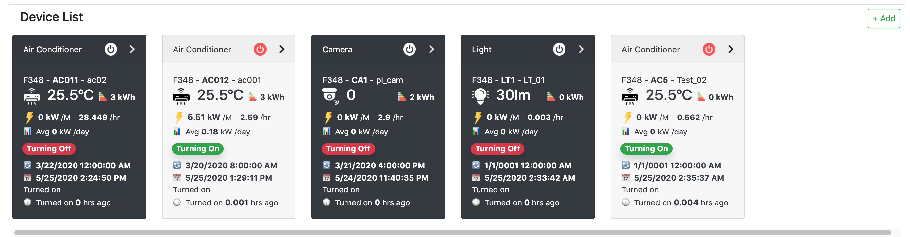
13
Room management & Real time monitor
Real time
Sensors and temperature, humidity, luminosity.
Heat index, Apparent temperature.
Thermal imaging

Slide 14
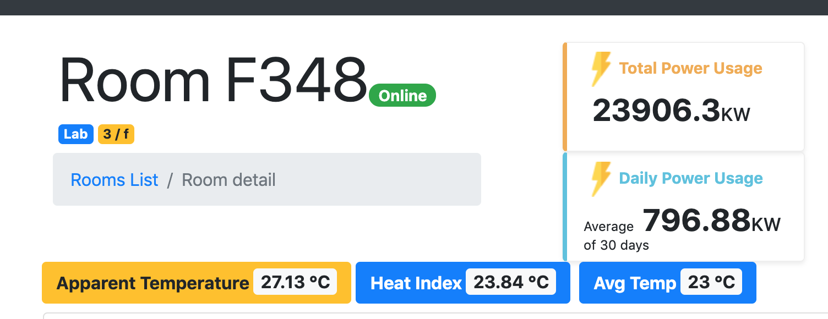
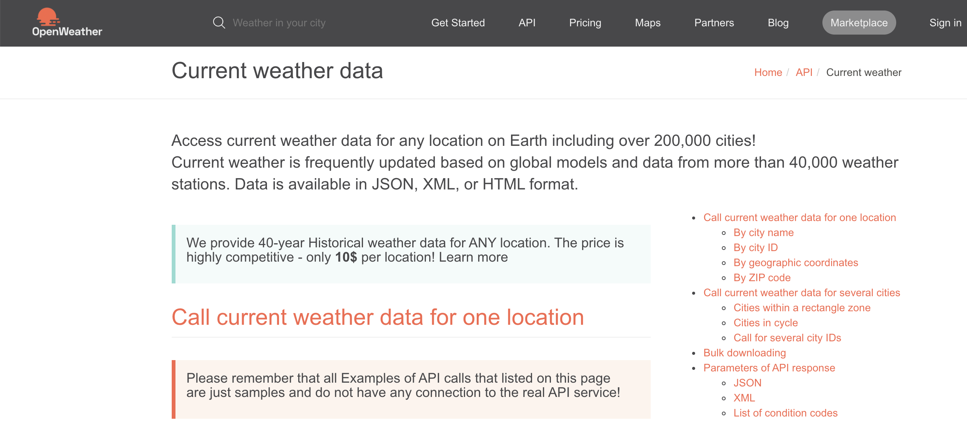
14
Real-time Indoor & outdoor environmental data
Data supporting control indoor environment
Indoor and outdoor temperature different affects heath
Provide regional weather information for tuning the indoor environment condition (Data from OpenWeatherMap)

Slide 15
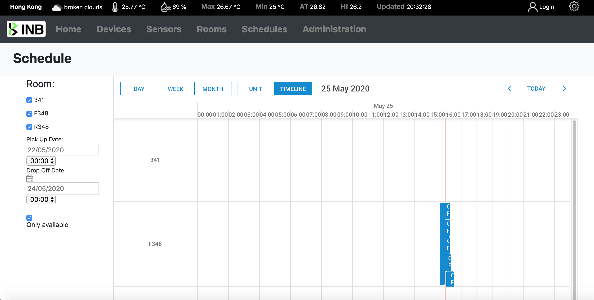
15
On schedule control room AC
A scheduled time-slot imported from the other system and show up in our system
The system will on schedule to warm-up the AC

Slide 16
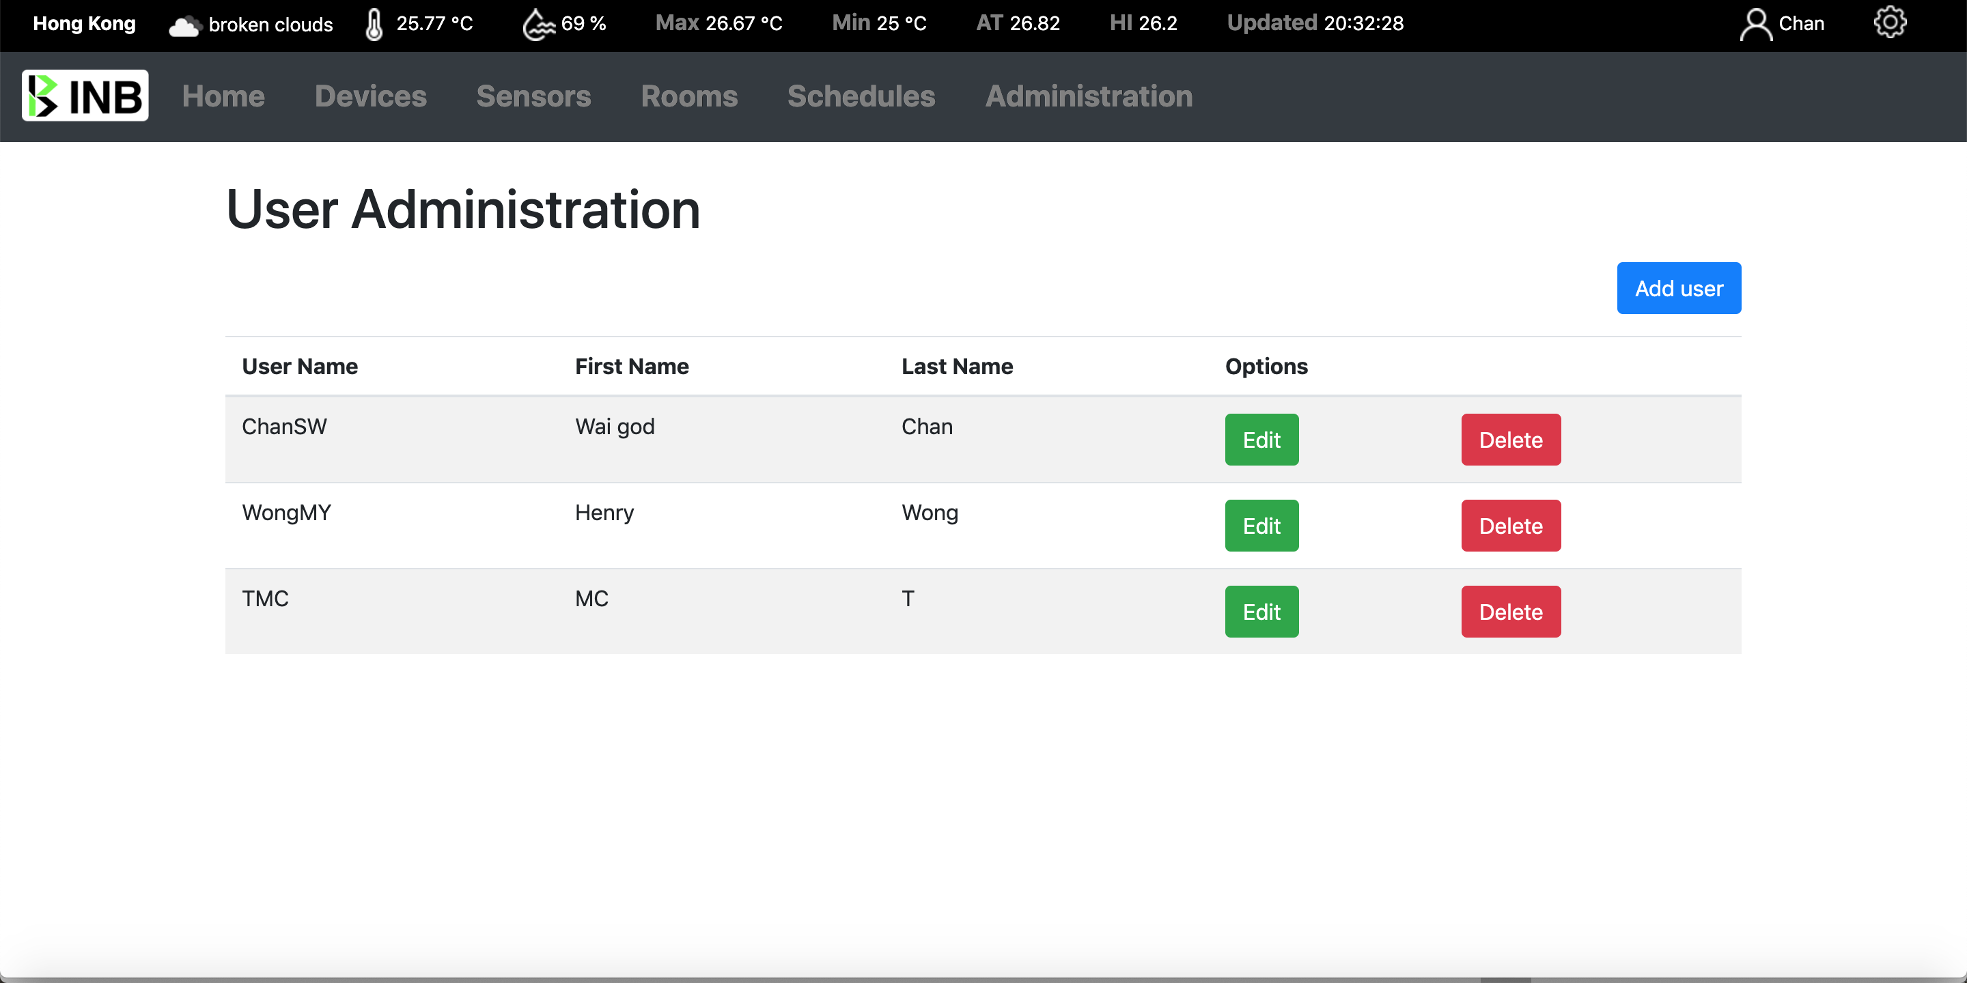
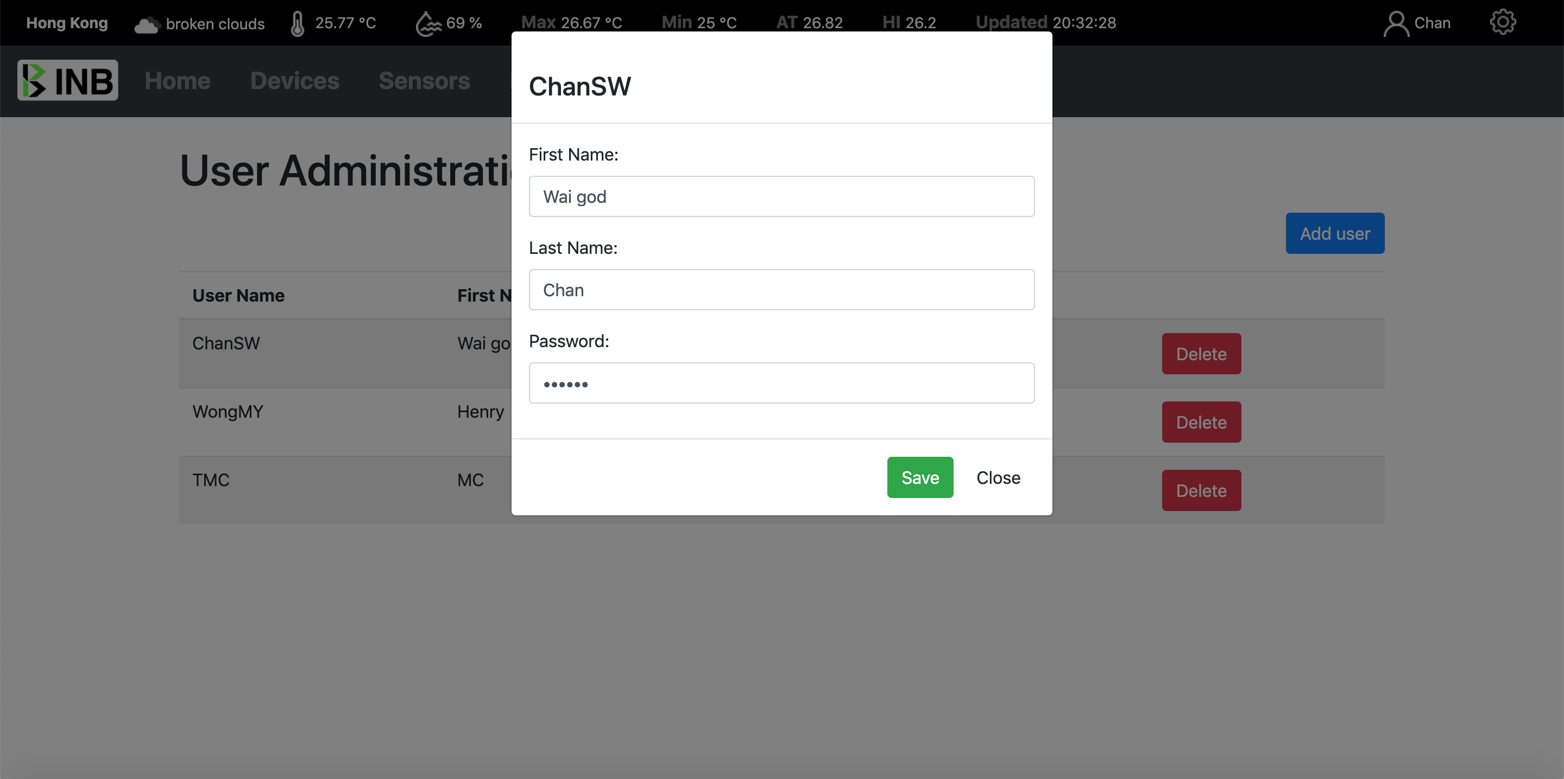
16
User Managements
Check, Edit, Add, Delete
Create, edit, delete users.

Slide 17
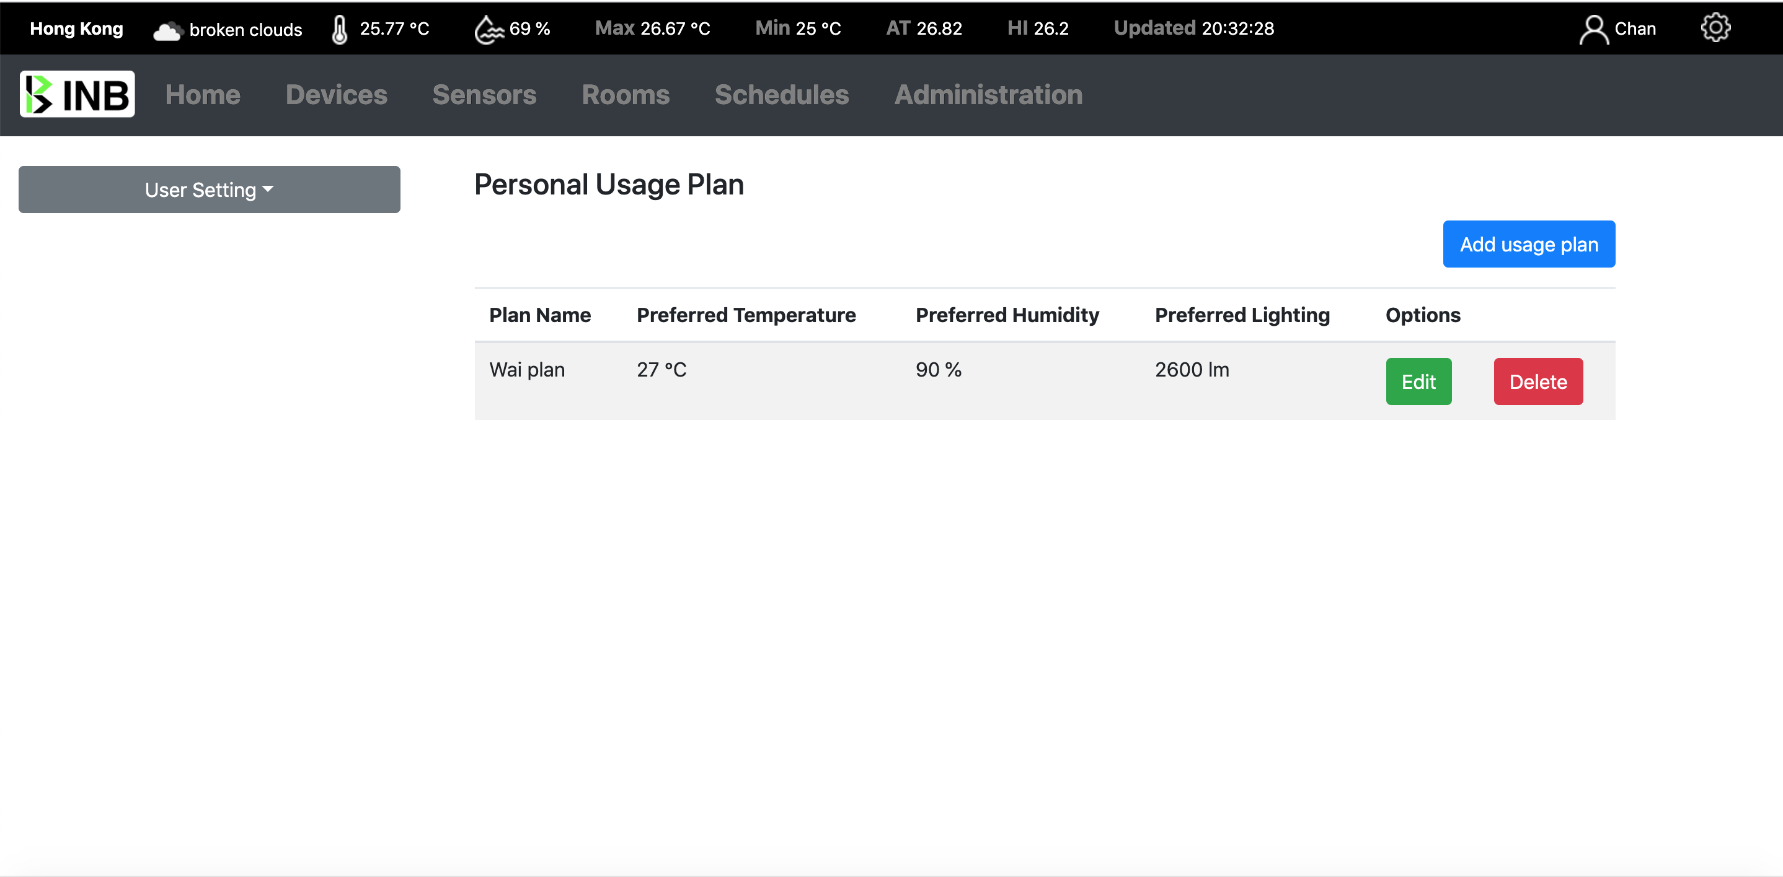
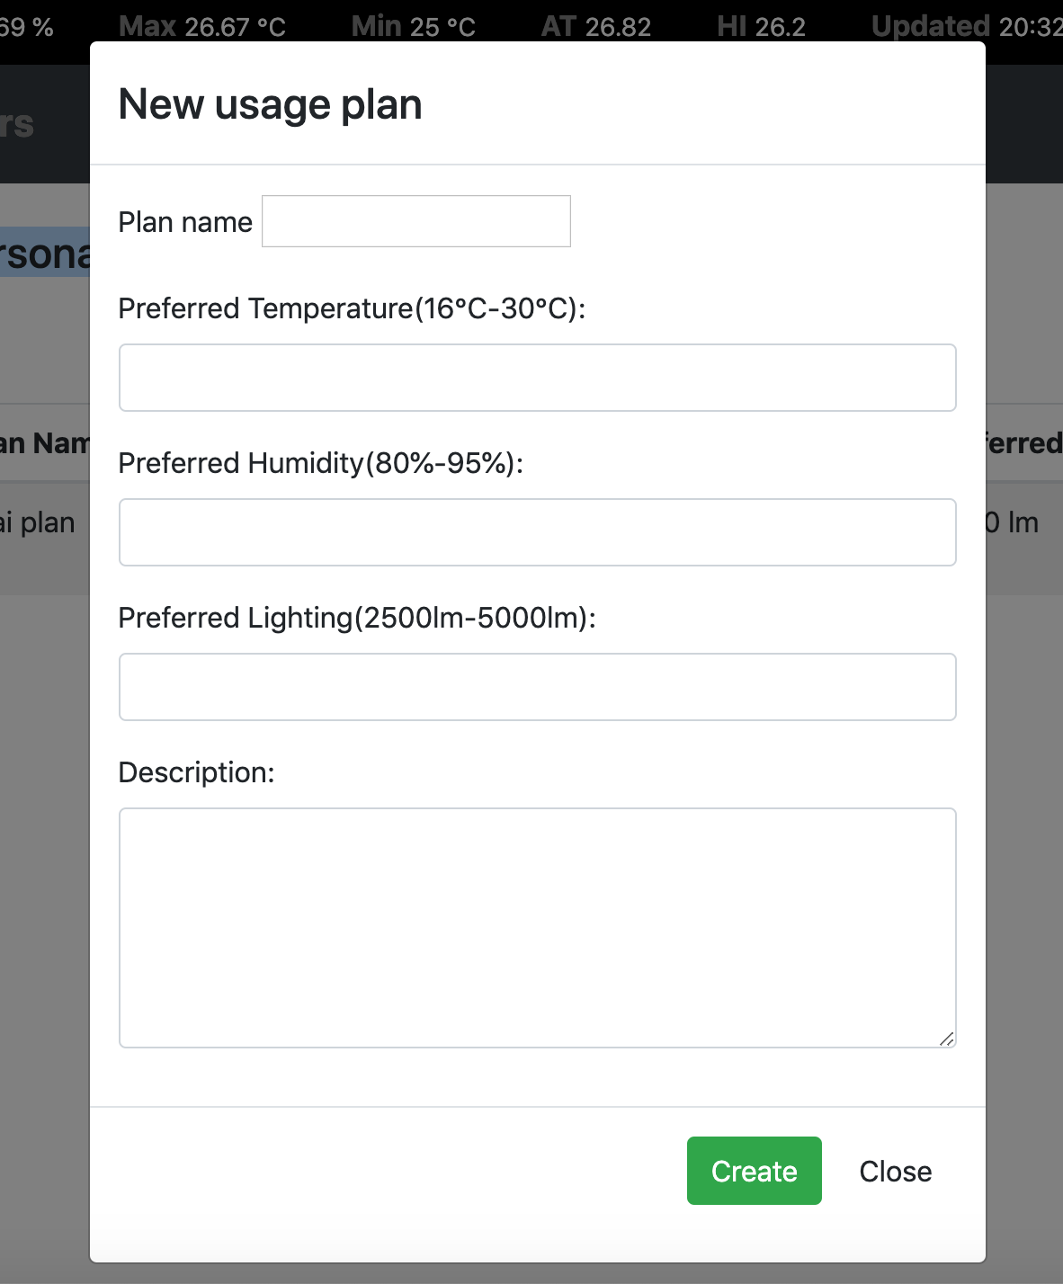
17
Personal Usage Plan
Check, Edit, Add, Delete
The usage plan can apply to the room
The room will according to the plan to set the temperature, humidity or lighting to a suitable value.

Slide 18
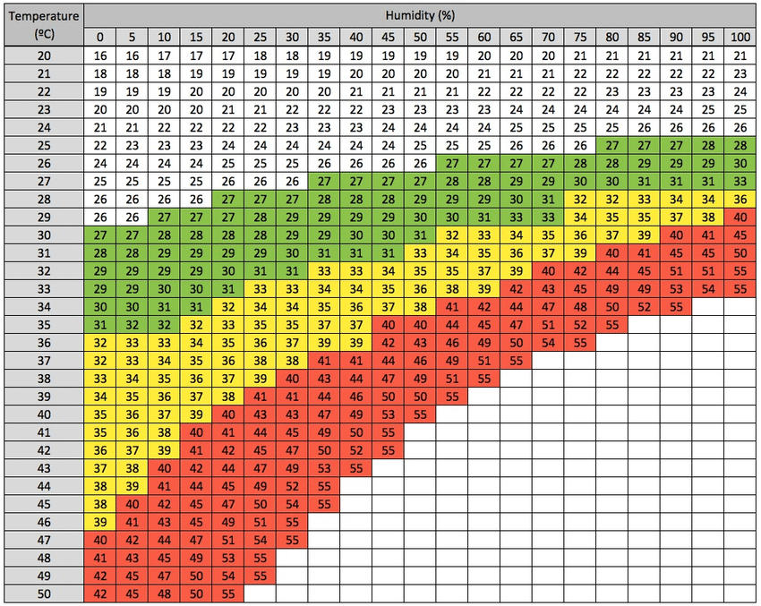
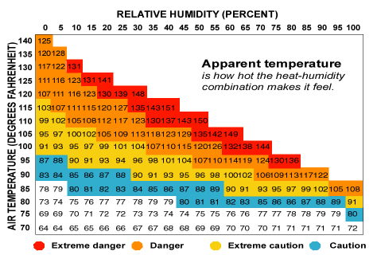
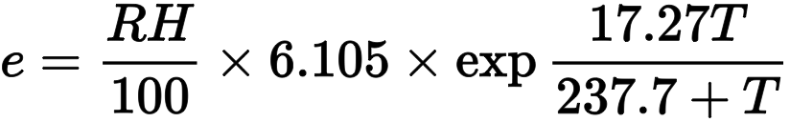
18
Heat Index & Apparent Temperature
For the intelligent to analyse and compare indoor and outdoor weather information
The algorithms adopt
with Cloud computing Service
Among them, AT is somatosensory temperature (° C), T is air temperature (° C), e is water pressure (hPa), V is wind speed (m / sec), and RH is relative humidity (%).
When the indoor temperature >= 26.7C, the system will use the indoor temperature and humidity to calculate the heat index, and according to the heat index to control the AC to a suitable temperature.
Otherwise when < 26.7C, the system will use Apparent temperature, and according to the Apparent temperature to control the AC to a suitable temperature.

Slide 19


19
Internet of Things Sensors
Install in different point within a room
Capture the data and return to the system real time

Slide 20

Thank you
More information, visit the project web site
http://13.75.55.240/

